Slide 1
BUSINESS
FREE PRESENTATION TEMPLATE

Slide 2

WELCOME MESSAGE
Your great headline here
Frequently, your initial font choice is taken out of your awesome hands also we are companies often specify a typeface, or even a set of fonts, part of their brand guides However
When selecting a typeface for body text, your primary concern should be readability. Don’t concern yourself with personality at this stage. I’m of the school of thought that believes that you’re better off mastering a few typeface.
KIM WHITE

Slide 3
OUR COMPANY HISTORY
YOUR GREAT SUBTITLE
LAUNCH
NEW BRAND
1990
2005
NEW LOCATION
NOW
Phenomenon whereby something new and somehow valuable is formed the created item
Phenomenon whereby something new and somehow valuable is formed the created item
1998
2017
Phenomenon whereby something new and somehow valuable is formed the created item
Phenomenon whereby something new and somehow valuable is formed the created item

Slide 4
OUR MISSION
YOUR GREAT SUBTITLE
WE
WANT
TO
BE
THE BEST
HOME
GREAT SUPPORT
Frequently, your initial font choice is taken out
Frequently, your initial font choice is taken out
SATISFACTION
AWESOME PICTURES
Frequently, your initial font choice is taken out
Frequently, your initial font choice is taken out

Slide 5
CONTENT OVERVIEW
YOUR GREAT SUBTITLE
WELCOME
ABOUT US
OUR MISSION
OUR VISION
OUR TEAM
OUR SERVICES
OUR PORTFOLIO
OUR DEVICES

Slide 6

Goals, strategies
content and marketing

Slide 7
OUR VALUES
YOUR GREAT SUBTITLE
HOME
SUPPORT
CHAT 24/7
MAILING
Frequently, your initial font choice is taken out of your awesome hand
Frequently, your initial font choice is taken out of your awesome hand
Frequently, your initial font choice is taken out of your awesome hand
Frequently, your initial font choice is taken out of your awesome hand

Slide 8




PREMIUM SERVICES
YOUR GREAT SUBTITLE
SERVICES
Frequently, your initial font choice is taken out of your awesome hands also we are companies often specify a typeface, or even a set of fonts, part of their brand guides However
Execute
Model
Analyze
Frequently your initial font choice is taken
Frequently your initial font choice is taken
Frequently your initial font choice is taken
MARCO MICHELLI

Slide 9
OUR SERVICES
YOUR GREAT SUBTITLE
01
02
03
RESEARCH
MARKETING
BRANDING
Frequently, your initial font choice is taken out
Frequently, your initial font choice is taken out
Frequently, your initial font choice is taken out
04
05
06
GRAPHIC DESIGN
SEO ANALYSIS
EMAILING
Frequently, your initial font choice is taken out
Frequently, your initial font choice is taken out
Frequently, your initial font choice is taken out

Slide 10



THE TEAM
YOUR GREAT SUBTITLE
General Manager
Marketing
Social Media
TOM MCKARTY
SAM BULLOCK
JOHNY COFFEE
Frequently, your initial font choice is taken
Frequently, your initial font choice is taken
Frequently, your initial font choice is taken

Slide 11
ARROW INFOGRAPHIC
YOUR GREAT SUBTITLE
01
TITLE 01
Frequently, your initial font choice is taken out of your hands; companies often specify
ANALYSIS
TITLE 02
Over the course of the last decade, however, we seem to have reached a general agreement that creativity involves the production of novel, useful products words, the production of something original and worthwhile..
02
Frequently, your initial font choice is taken out of your hands; companies often specify
TITLE 03
03
Frequently, your initial font choice is taken out of your hands; companies often specify
TITLE 04
Frequently, your initial font choice is taken out of your hands; companies often specify
04

Slide 12
Business Strategy
Presented by: Louis Twelve

Slide 13

“
There are no secrets to success. It is the result of preparation, hard work, and learning from failure.
Colin Powell
”

Slide 14
Meet our Team
Your subtitle goes here
Oliver Queen
Jane Snow
Mary Park
Louisa Twelve
CEO & Founder
Finances Department
Marketing Manager
Graphic Designer

Slide 15

Our Common Services
Your subtitle goes here
Graphic Design
Sound Design
Photography
Cloud Service
Entrepreneurial activities differ substantially depending on the type of organization and creativity.
Entrepreneurial activities differ substantially depending on the type of organization and creativity.
Entrepreneurial activities differ substantially depending on the type of organization and creativity.
Entrepreneurial activities differ substantially depending on the type of organization and creativity.
Entrepreneurial activities differ substantially depending on the type of organization and creativity. Entrepreneurial activities differ substantially depending on the type of organization and creativity. Entrepreneurial activities differ substantially depending on the type of organization and creativity. Entrepreneurial activities differ substantially. Depending on the type of organization and creativity. Entrepreneurial activities differ substantially depending on the type of organization and creativity. Entrepreneurial activities differ substantially.

Slide 16

App Project Sample
Your subtitle goes here
Feature One
Feature Three
Entrepreneurial activities differ substantially depending on the type of organization and creativity.
Entrepreneurial activities differ substantially depending on the type of organization and creativity.
Feature Two
Feature Four
Entrepreneurial activities differ substantially depending on the type of organization and creativity.
Entrepreneurial activities differ substantially depending on the type of organization and creativity.

Slide 17
Comparison Chart
Your subtitle goes here
Chart Sample One
Chart Sample Two
Entrepreneurial activities differ substantially depending on the type of organization and creativity. Entrepreneurial activities differ.
Entrepreneurial activities differ substantially depending on the type of organization and creativity. Entrepreneurial activities differ.

Slide 18
Six Steps Process
Your subtitle goes here
Entrepreneurial activities differ substantially depending on the type of organization and creativity. Entrepreneurial activities differ.
Entrepreneurial activities differ substantially depending on the type of organization and creativity. Entrepreneurial activities differ.
01
04
Entrepreneurial activities differ substantially depending on the type of organization and creativity. Entrepreneurial activities differ.
Entrepreneurial activities differ substantially depending on the type of organization and creativity. Entrepreneurial activities differ.
02
05
Entrepreneurial activities differ substantially depending on the type of organization and creativity. Entrepreneurial activities differ.
Entrepreneurial activities differ substantially depending on the type of organization and creativity. Entrepreneurial activities differ.
03
06

Slide 19
Pyramid Diagram
Your subtitle goes here
Three Important Values to
Increase the participation.
Entrepreneurial activities differ substantially depending on the type of organization and creativity. Entrepreneurial activities differ substantially depending on the type of organization and creativity. Entrepreneurial activities differ substantially depending on the type of organization and creativity. Entrepreneurial activities differ
Key Three
Key Name Two
20%
75%
25%
Key Name Number One

Slide 20
Get in Touch with Us
Your subtitle goes here
Our Location A
Our Location B
Our Phone
Email / Website
1234 Avenue Richmond
Houston, Texas
ZIP 77090 - 77000
1234 Avenue Richmond
Houston, Texas
ZIP 77090 - 77000
(832) 123 4567
(832) 456 4567
(832) 987 4567
louistwelve@gmail.com
www.louistwelve.com

Slide 21
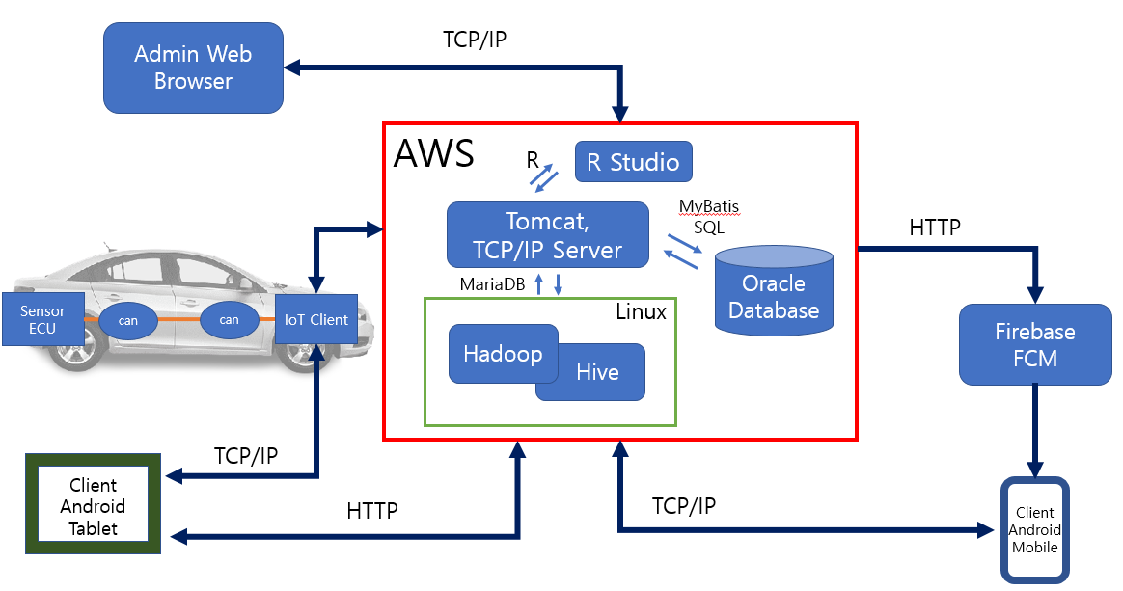
시스템 구성도

Slide 22
전체 요구사항
핵심기능
No | 요구사항 명 | No | 요구사항 명 | No | 요구사항 명 | No | 요구사항 명
1 | 일반 로그인 | 10 | 영유아 차량 내 방치 알림 | 19 | 차량 상태 조회(시동, 온도, 도어) | 28 | 차량 로그 생성
2 | 소셜 로그인 | 11 | 원하는 서비스 설정 | 20 | 운전 환경(날씨) 알림 | 29 | 로그인 로그 생성
3 | 회원가입 | 12 | 차량 상태 조회(센서) | 21 | FCM 수신(기능별 분기) | 30 | 차량 정보 api
4 | 회원탈퇴 | 13 | 화물차량 적재물 위험 알림 | 22 | 소모품 가격 확인(M) 및 주변 공업사 위치 확인(T) | 31 | GPS
5 | 회원 정보 수정 | 14 | 졸음 운전 위험 알림 | 23 | FCM 송신 | 32 | 사고시 119/보험사 알림
6 | 아이디 중복 메시지(회원가입 시) | 15 | 텍스트 음성 변환 | 24 | 사용자 통계 (가입회원수, MAU) | 33 | 화면설계
7 | 오류메시지(로그인 실패 등) | 16 | 실시간 화장실 가용 정보 | 25 | 사용자 위치 시간별 통계 | 34 | DB설계
8 | 1:1채팅 | 17 | 실시간 공영주차장 가용 정보 | 26 | 심박 로그 생성 | 35 | 단위테스트/통합테스트
9 | 차량 추가/제거 | 18 | 차량 원격 제어(에어컨, 시동, 도어) | 27 | 무게 로그 생성 | 36 | 현재 위치 지도로 보여주기

Slide 23





핵심 기술
IoT 세이프 모빌리티 시스템
적재물 낙하알림
영유아 고립
사고 방지
졸음감지
및 알람
교통사고
감지 및 신고
차량 밀집지역 확인
Frequently, your initial font choice is taken out of your awesome hand
Frequently, your initial font choice is taken out of your awesome hand
Frequently, your initial font choice is taken out of your awesome hand
Frequently, your initial font choice is taken out of your awesome hand
Frequently, your initial font choice is taken out of your awesome hand

Slide 24
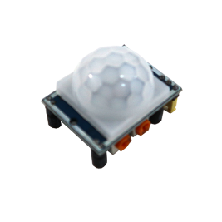

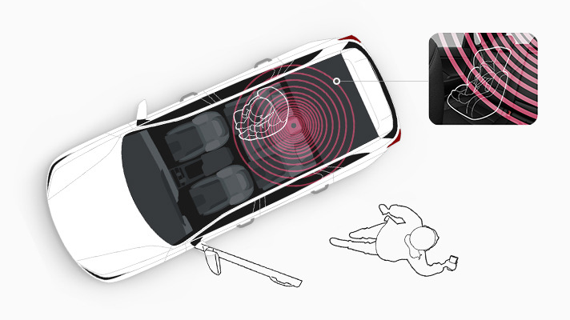
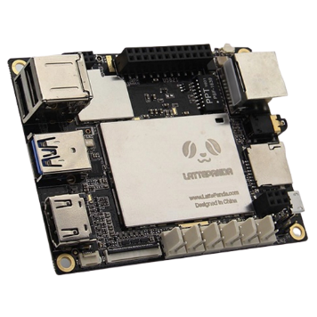


핵심 기술 구현 방안
1.영유아 고립사고 방지
PRI센서
라떼판다
Server
FCM
안드로이드
스마트폰
Notes:
첫번째 핵심기능은 영유아 고립사고 방지 기능입니다

Slide 25
핵심 기술 구현 방안
1.영유아 고립사고 방지
PRI센서
Notes:
첫번째 핵심기능은 영유아 고립사고 방지 기능입니다

